Slide 1
AI-Powered Personalized Learning Assistant for School and College Students

Slide 2
agenda
Introduction
Problem Statement
Data Insights & Key Findings
Model Approaches
Business Use Cases

Slide 3

Problem Statement

Slide 4

In today’s education system, students have diverse learning speeds, styles, and
preferences. Traditional teaching methods often follow a "one-size-fits-all"
model, which leaves slow learners behind and fails to challenge fast learners.
Teachers are overwhelmed with managing large classrooms and cannot provide
individual attention. Moreover, students struggle to revise concepts effectively
and lack personalized guidance outside school hours. Current EdTech
platforms offer video content and static quizzes but do not adapt dynamically to
student behavior or performance.

Slide 5
Data Insights & Key Findings

Slide 6
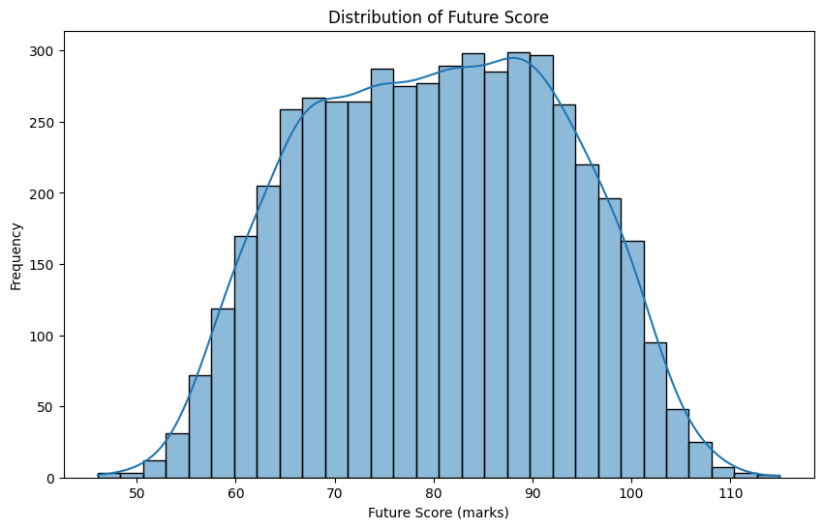
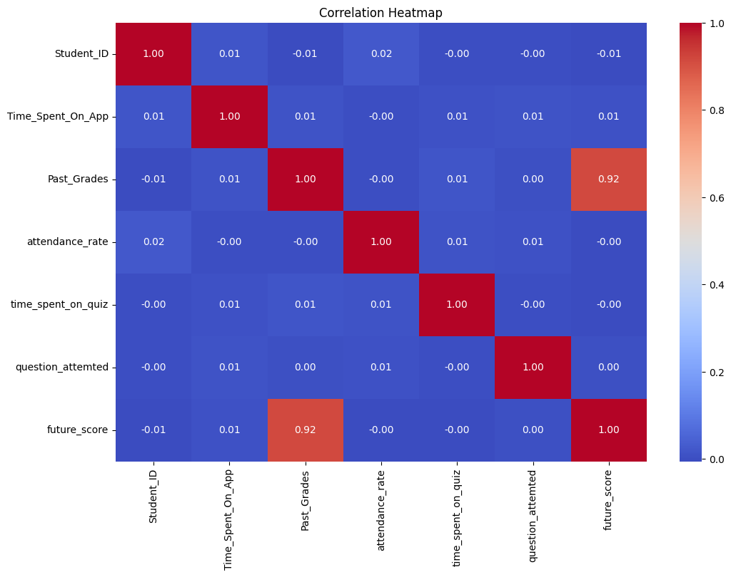

Slide 7
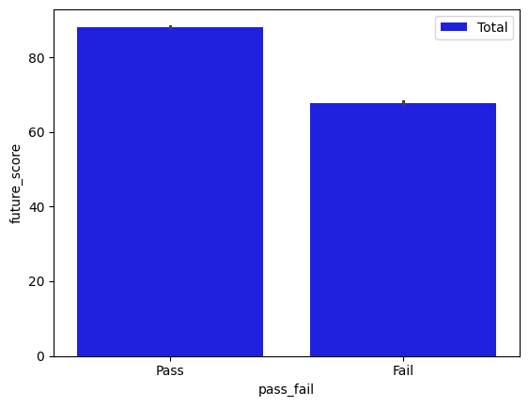

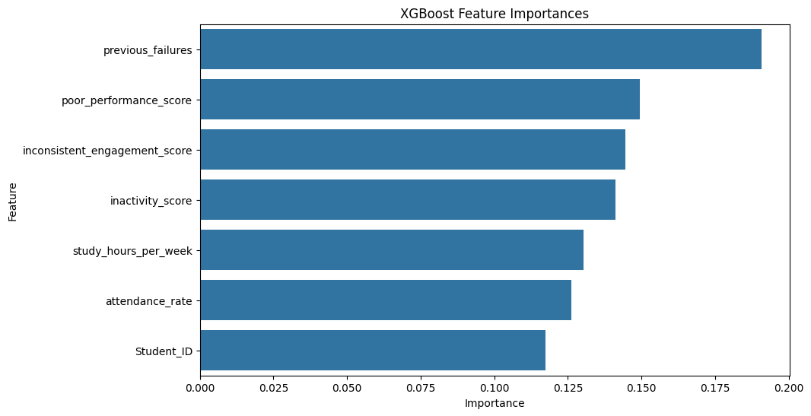

Slide 8

Model Approaches
ML – MODELS:
For pass/fail: used randomforest classifier
For score range prediction: used random forest regressor
For dropout risk detector: used XGBoost Classifier.
For Topic Detection from Student Answers: used BiLSTM
For Handwritten Digit Recognition: MINST datasets.
For AI-Based Topic Summarizer: used T5.

Slide 9
Business Use Cases
EdTech companies can integrate the solution into their LMS to provide customized learning paths.
Schools and colleges can use the assistant for remedial coaching and curriculum support.
Parents gain insights into their child’s learning behavior and can take early action.

Slide 10
Thank you
Simran Paul
simranpaul1010@gmail.com

